Slide 1
Font Glutter
Yunzi Liu

Slide 2
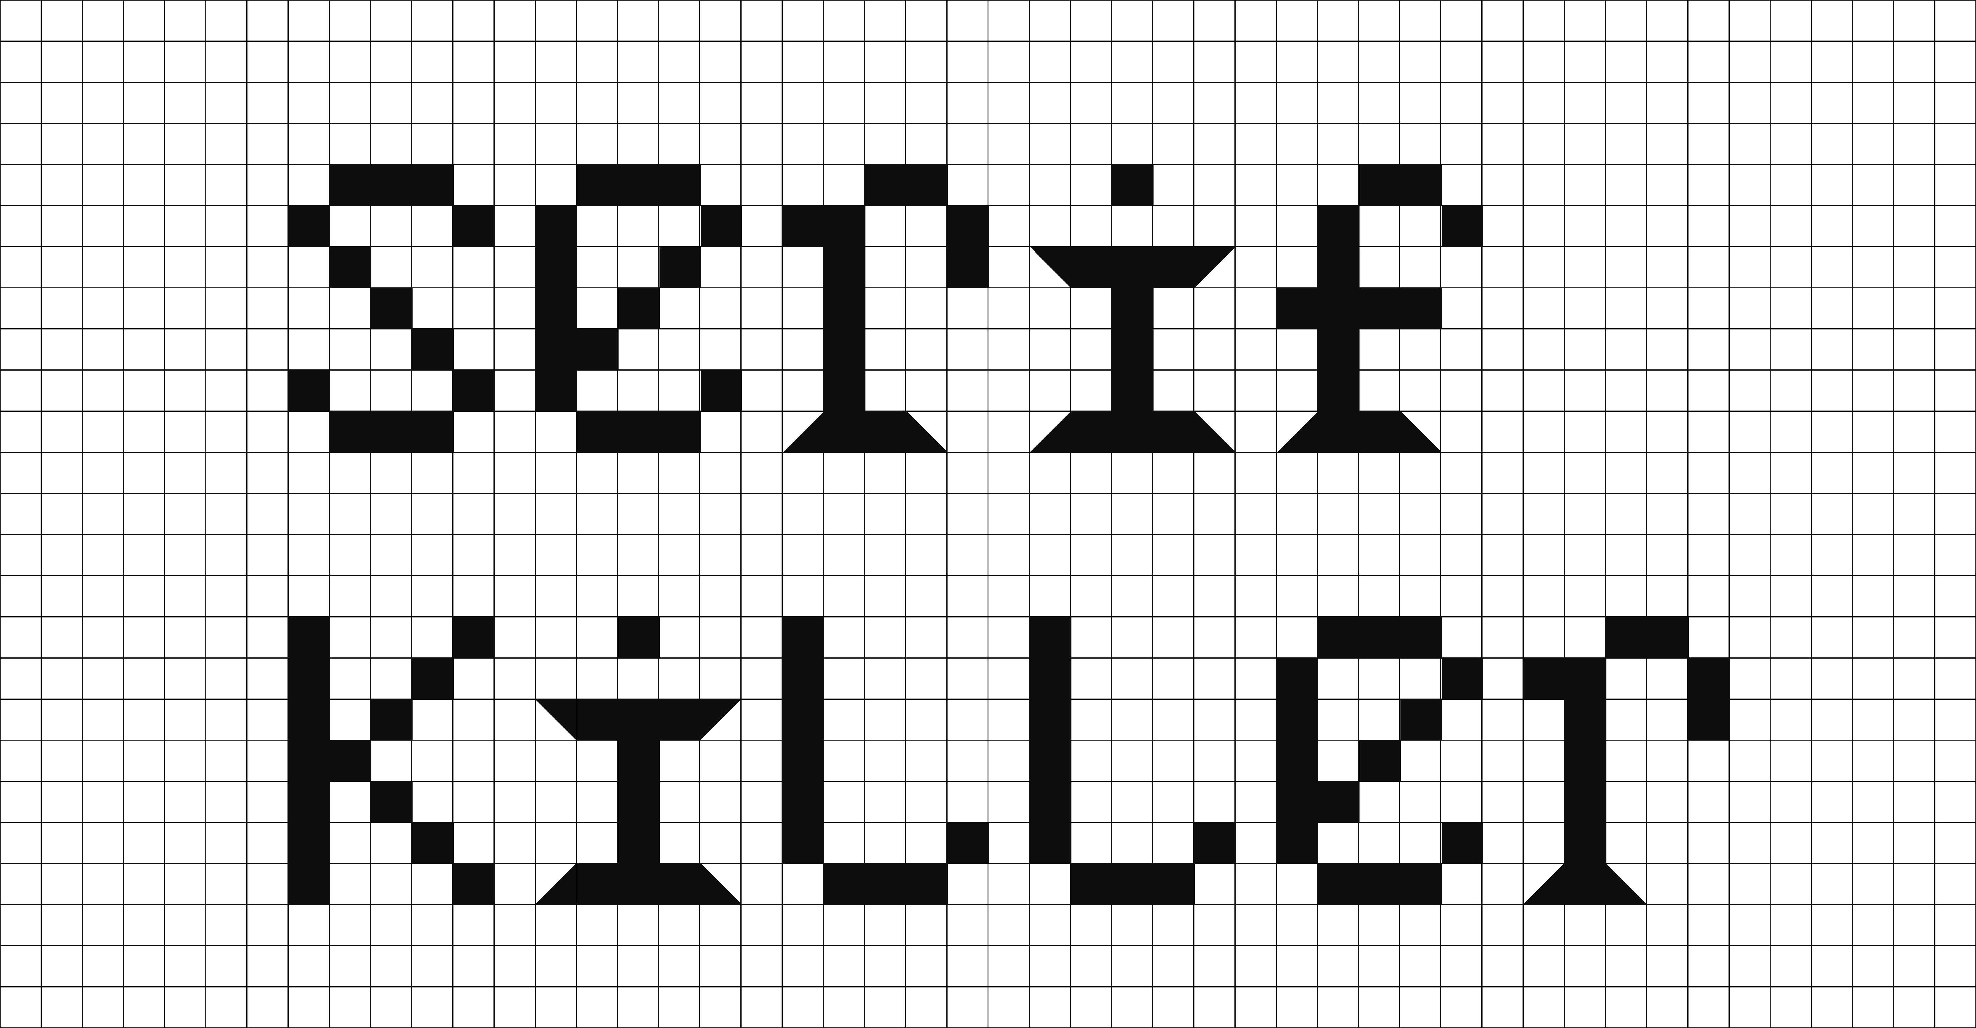
First Idea
Serif Killer

Slide 3
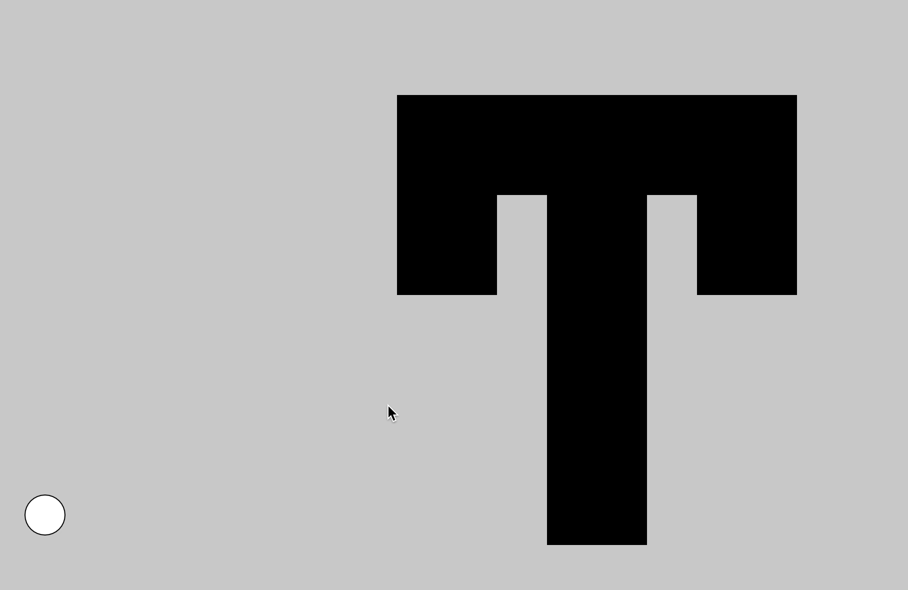
My prototype

Slide 4

Problem: concept / jumping

Slide 5
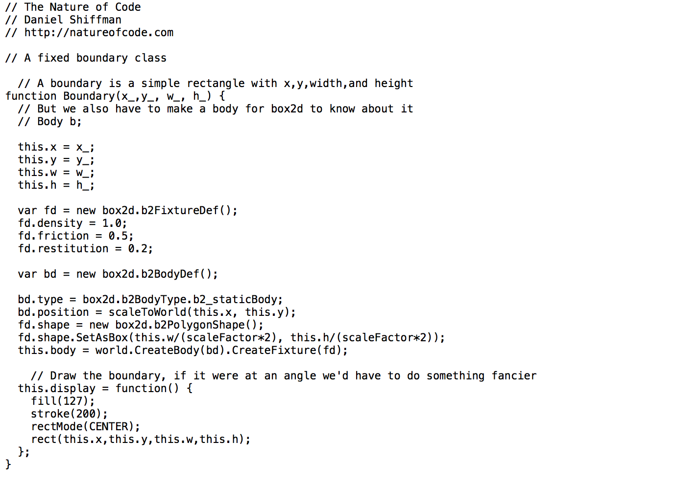
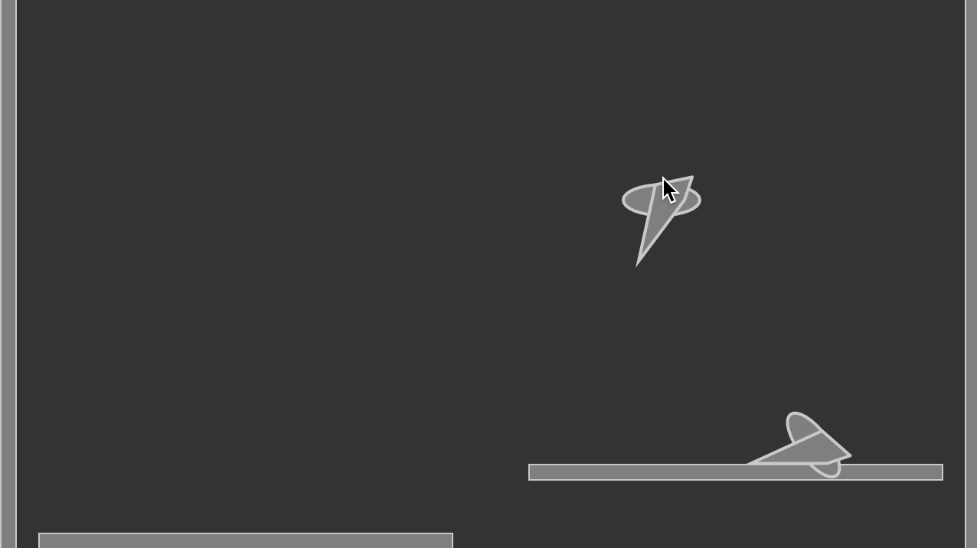
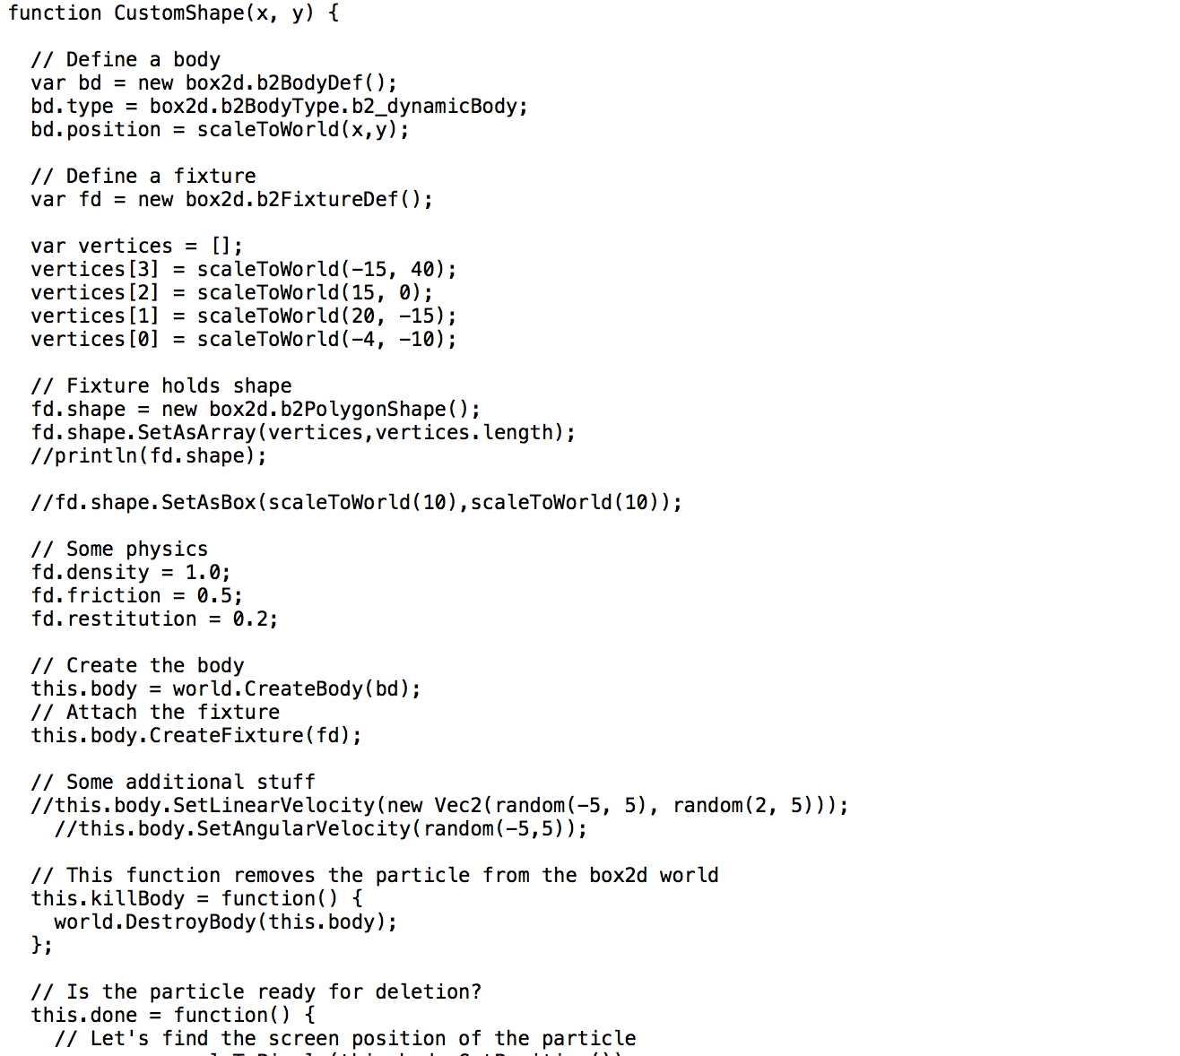
To solve this I tried 2d world,
but I couldn’t completely understand

Slide 6
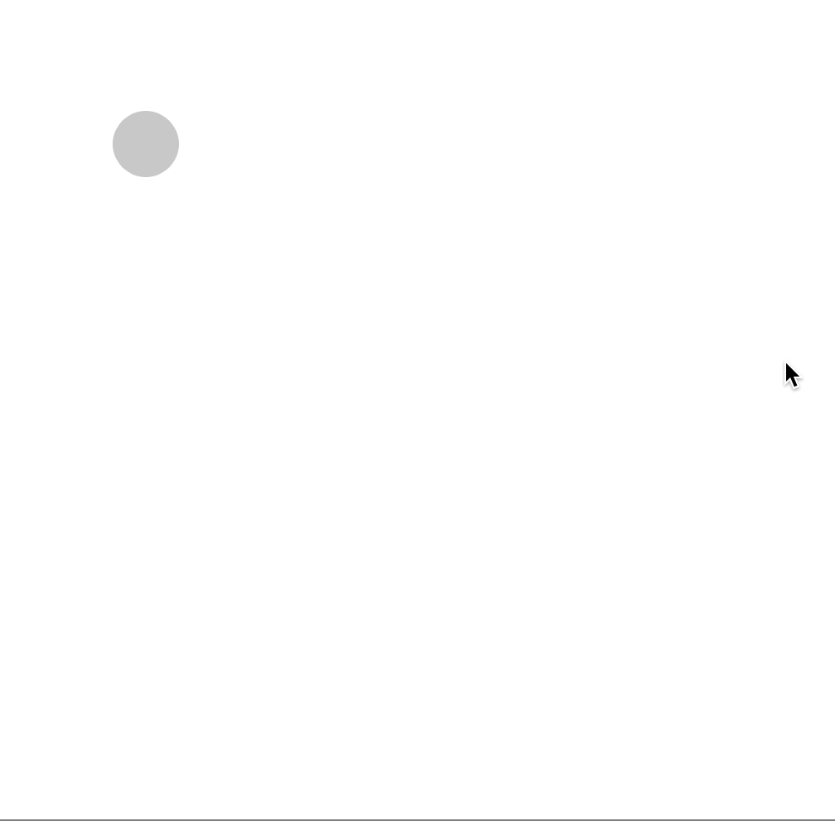
I talked to my friends and got some new ideas,
such as creating a maze to change a perspective.
So I came back to the beginning and started with a simple prototype.

Slide 7
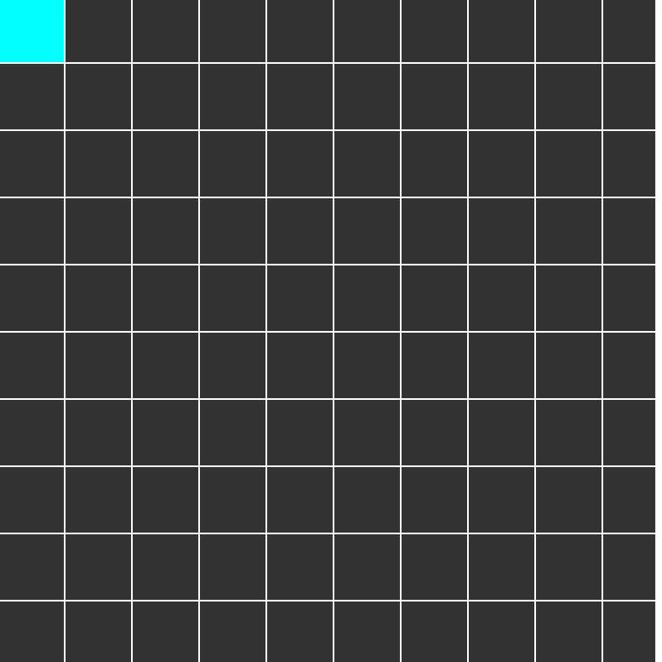
I tried Dan’s way to make a maze generator, but still,
I did not know how to adopt this into my game.

Slide 8

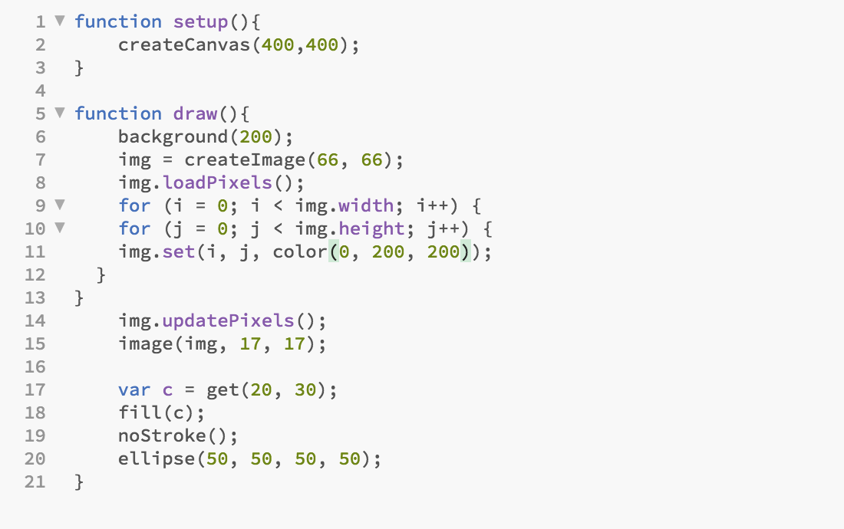
Another attempt for adding a maze was checking pixels. I consoled it and it checked
pixels successfully, however, the ellipse could not stop at the wall.

Slide 9

I also tried the snake game, because I want
the player to eat something in the maze, which
can provide some information about typography
or typefaces.

Slide 10
Second Idea
Make some blocks for the players and hinders and they can control
the movement of the moving character to eat the “food” which contains
the name, brief introduction, and the regular specimen.
I still use the moving ellipse as the prototype for the character, then I
downloaded the play.js library to make a simple prototype for level 1, then
I added more scenes.

Slide 11
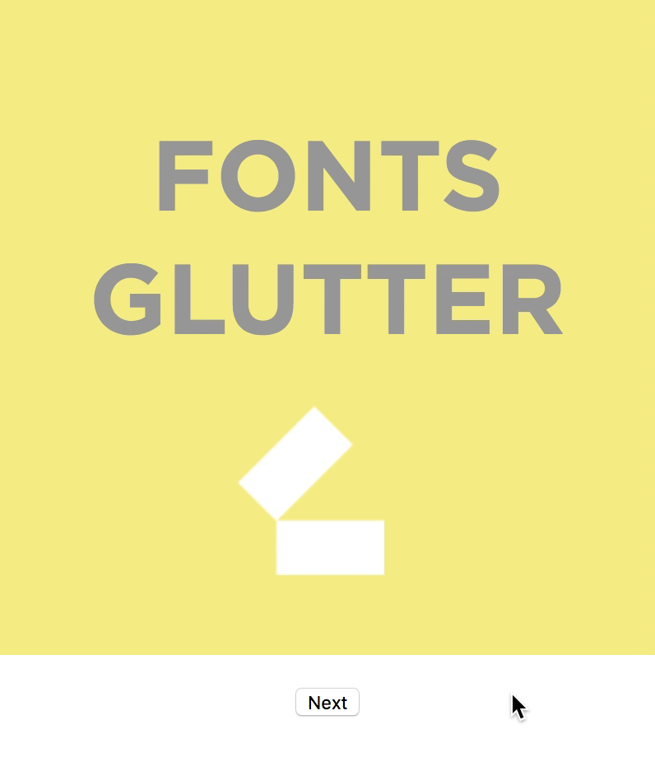
Future ways to go:
1. add more buttons so that
players can choose from “play
it again” and “next level”;
2. eliminate the mousePressed
action after the scene “Level X”;
3. Complete the plot after eating
those fonts;
4. Show what the players have
“eaten” on the right.

